Slide 1
Flight Delays
Final Presentation
Team 25
Jaclyn Andrews, Alyssa Augsburger, John Lee
December 12, 2020
Notes:
JOHN
Hi, we are Team 25 with Jaclyn, Alyssa, and myself, John. In this presentation, we will present on our approach to predicting Flight Delays.

Slide 2
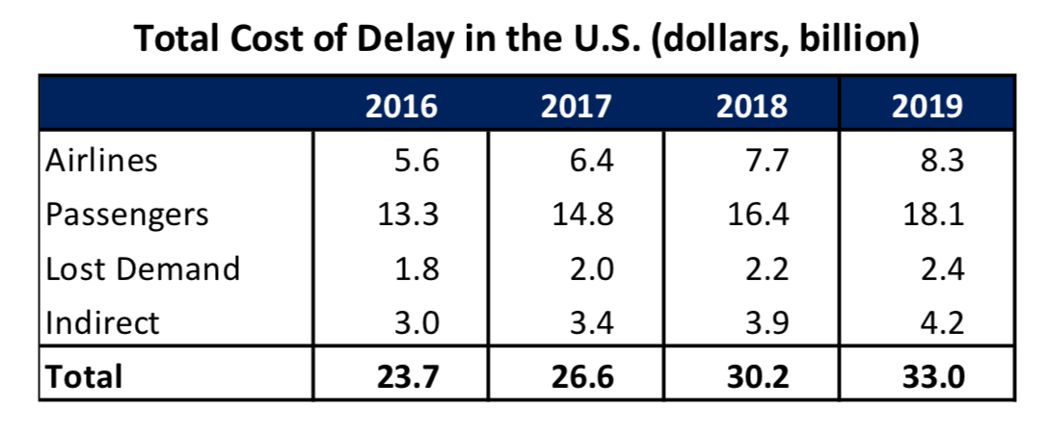
Question Formulation
Question:
Given flight and weather information known two hours ahead of planned departure time, will a flight depart on time (within 15 minutes of scheduled departure) or will it be delayed or cancelled?
Evaluation:
F1 Score - to minimize both false positive and negatives
State of the Art (on a subset of data):
F1 Score of 0.85
https://www.faa.gov/data_research/aviation_data_statistics/media/cost_delay_estimates.pdf
Notes:
JOHN
The problem that we’re tackling is that flight delays cost airlines and passengers tens of billions of dollars each year. These cost include passengers missing connections or airlines having lower aircraft utilization. With accurate delay predictions, we can minimize costs by planning ahead.
The question in our project was: Given flight and weather information known two hours ahead of planned departure time, will a flight depart on time or will it be delayed or cancelled?
Our evaluation metric is F1 score because we want to find the balance between precision and recall to minimize both false positive and negatives. False positive imply predicting a delay when there isn’t one. False negatives imply predicting no delay when there is. We focused on designing a model for an alert system that informs airlines and passengers of potential delays to start preparing for mitigation. Therefore, we prefer a false positive.
The current state of the art on a small dataset of 5 airports shows an F1 Score of 0.85. However, our data would be for hundreds of airports in the US but this gives us something to compare our results to.
_________________________________________________________________
False positives > false negatives
have false positives or false negatives leading them
Our evaluation metric is recall because our research indicates that the biggest expense in delayed flights is from people missing connecting flights. If delayed flights are predicted, people can get on a different flight to still meet their connecting flights. Therefore, more false positives is preferred than false negatives meaning that recall will be a more important metric.
____________________________________
We be optimizing the F1 score from predicting if a flight’s departure will be cancelled or delayed by >15 min. F1=2*(precision*recall)/(precision+recall)
Accuracy = (TP + TN) / (TP + FP + TN + FN)
Precision = TP / (TP + FP)
Recall = TP / (TP + FN)
F1 = 2* (Precision*Recall) / (Precision + Recall)
F1 score is chosen because we value False Negatives and False Positives.
False negatives would predict no delay when flights are delayed leading to angry passengers.
False positives would predict delay when no delay, leading to passengers not arriving on time and causing an actual delay.
False Positive = expend money on things they didnt need to
False Negative = behind schedule, hurts operations down the line, domino

Slide 3
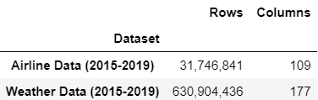
Data Introduction
Flights Data:
Reporting Carrier On-Time Performance (Bureau of Transportation Statistics)
2015 through 2019 U.S. Flights Data
Weather Data:
National Oceanic and Atmospheric Administration Repository
2015 through 2019 Weather Data
Notes:
The flight data used in predicting flight delays were obtained from the Bureau of Transportation Statistics from 2015 to 2019.
The supplemental weather data is from NOAA repository over the same time period.
These large datasets of millions of rows are great candidates to utilize a parallel computing framework for machine learning classification.

Slide 4







Our Process
EDA + Data Pre-Processing
Feature Engineering
Join Data
Train Machine Learning Models
Evaluate Results
Fine Tune Models
Notes:
JOHN
Here is our overall process, starting with data pre-processing and ending with iterative fine tuning until we are satisfied with our results.
While this is straightforward, the actual path was more convoluted where we would move two steps forward and one-step back as more ideas were generated throughout the process leading us to go back and improve previous steps.
We will discuss each of these steps in more detail.

Slide 5
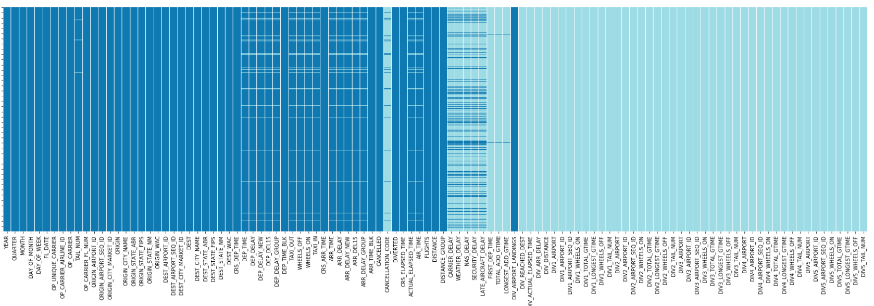
EDA: Large Dataframes
Challenge: High computational complexity
Solution: Filter and sub-setting (asw)
Challenge: Handling nulls
Solution: Drop training nulls & impute test nulls
Viable features
Taxi, arrival, in flight details
Delay and diversion details, mostly null
Code:
Notes:
We begin with exploratory data analysis and the challenges we ran into.
One of the more difficult challenges is working with this large dataframe with many null values. The image shows 3-months of data where the light blue cells show many null values.
Our solution to most efficiently work with this data was to filter and sub-set the data as much as possible and work in “a small world” to test our codes, theory, and performance of models. After filtering, the remaining null values in the training dataset were dropped. The validation & test null data were imputed with average values from the training dataset.

Slide 6
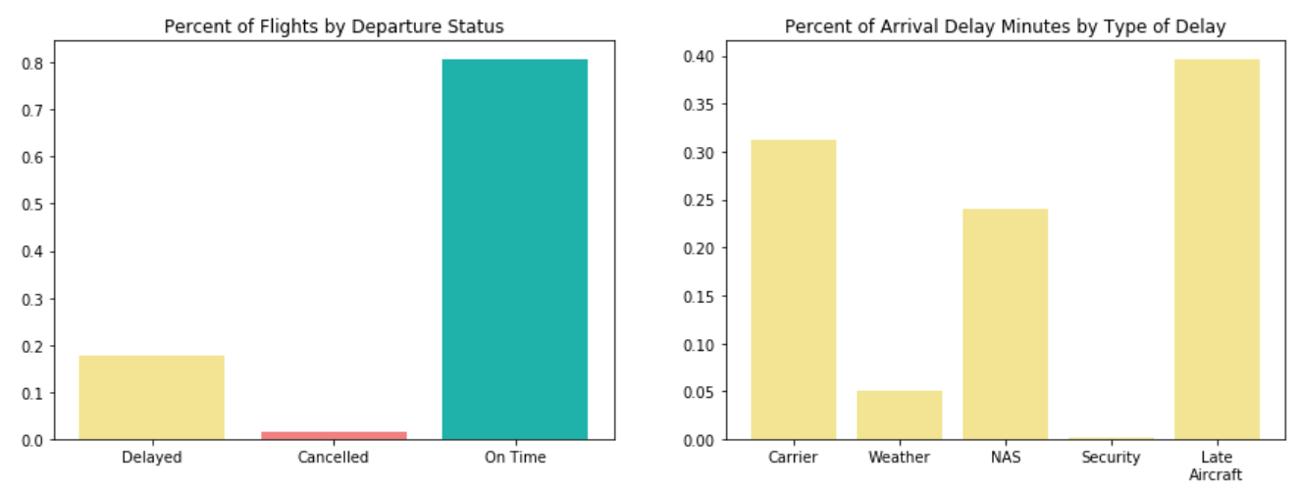
EDA: Outcome Variable
Challenge: Unbalanced data
Solution: Sampling weights
Challenge: Various separate causes of delay
Solution: Customized feature creation
Notes:
There were also challenges from the delay outcome variable.
One challenge was the unbalanced data with a majority class of no delays which biased our results in favor of, predicting no delays. We treated this by utilizing sample weights.
Another challenge was that flights can be delayed for various reasons, not just inclement weather, so we will craft custom features to help our model learn.

Slide 7
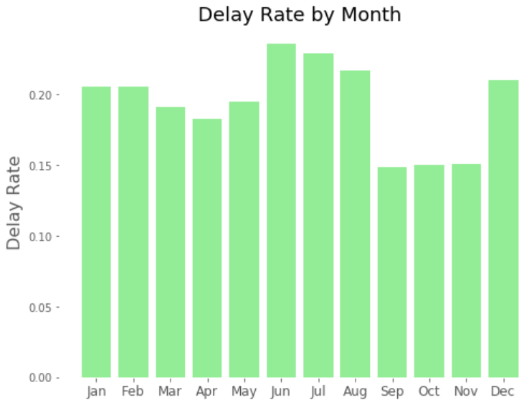
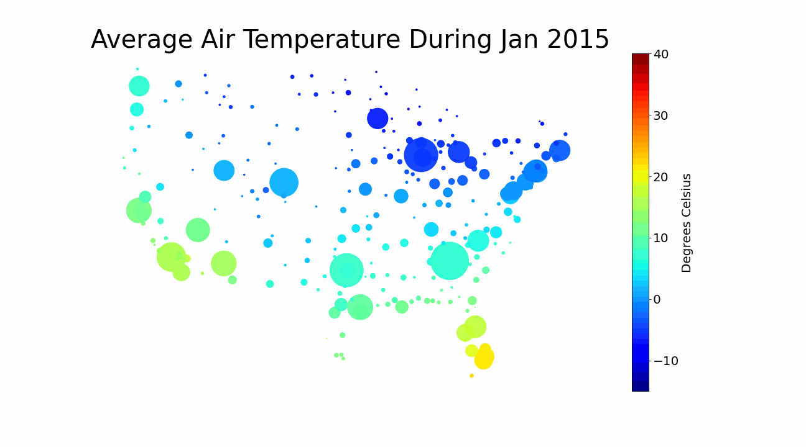
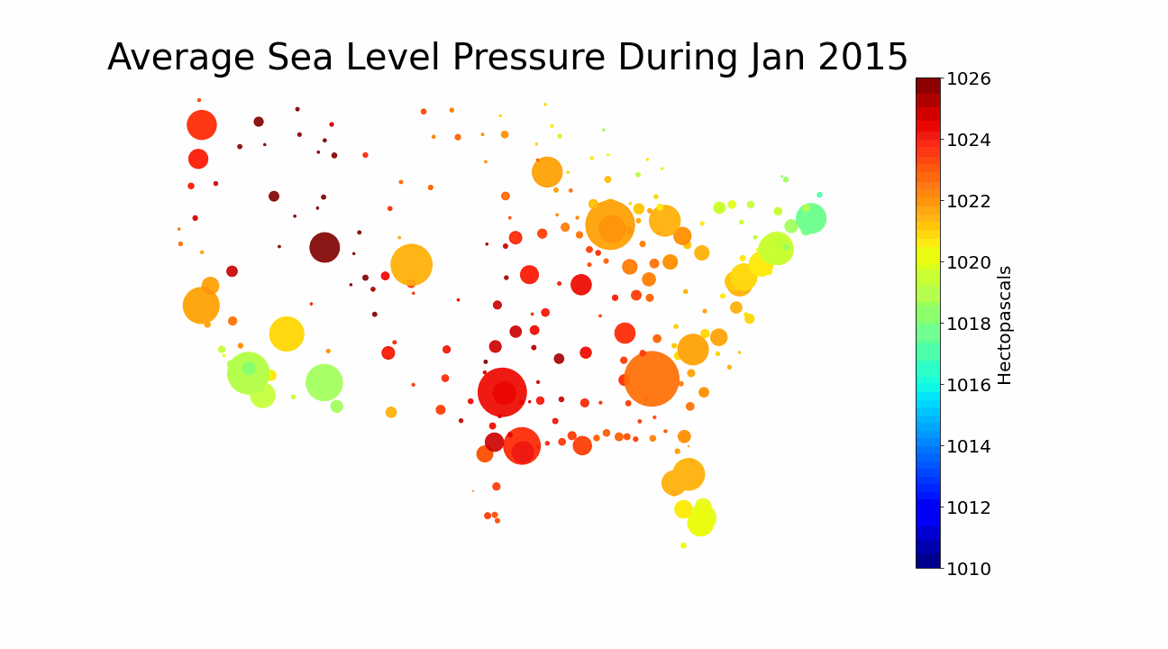
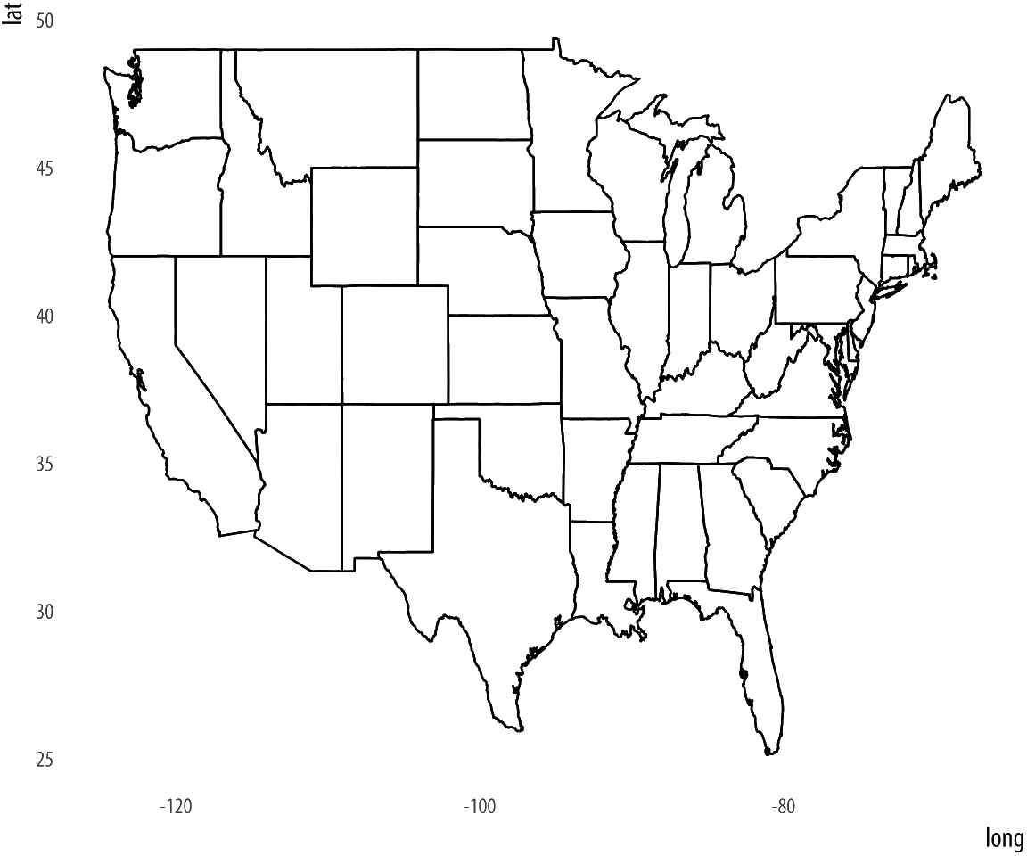
EDA: Seasonality
Challenge: Capturing the variances in seasonality
Solution: Split data into train/validation/test by year
Notes:
Through our data exploration, we noticed a recurring theme of seasonality. Many weather metrics including air temperature and sea level pressure followed seasonal patterns as seen here with a color scale of average weather for each airport weather station and the dot size reflecting flight volume. We can see clearly in green that delay rate is not steady throughout the year, but ebbs and flows with the seasons.
We want to train on all seasons to capture this variance and evaluate the success of our model across all seasons. To prevent data leakage, we split our data into a 3 year training set from 2015 to 2017 and 1 year validation and test sets in 2018 and 2019.

Slide 8
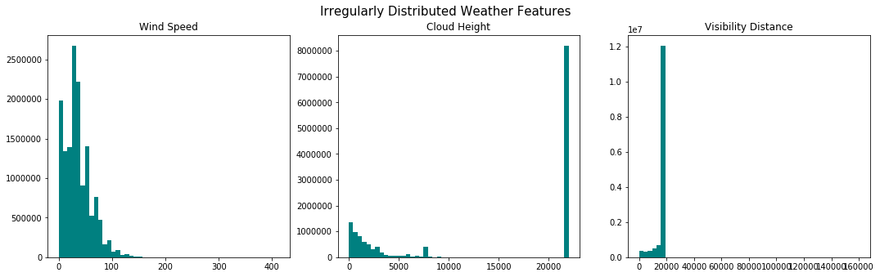
EDA: Weather Data Abnormalities
Challenge: Data is not normally distributed
Solution: Binned data on splits
Notes:
Here we see that several weather features were not normally distributed. Our solution was to bin the data, treating them as categorical or binary.

Slide 9
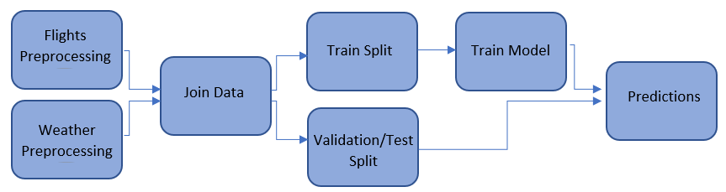
Data Processing: Pipeline
31,746,841 / 109
31,737,432 / 22
14,771,645 / 36
31,534,960 / 51
630,904,436 / 177
22,283,287 / 21
7,170,842 / 36
7,307,855 / 36
Legend: Rows / Columns
Notes:
With the knowledge from our EDA, we were able to transform the raw data into prediction results.
The first pre-processing step reduced the large data frames and allowed us to use less compute resources. The joining of the data was easier with the small dataset.
Then we split the data based on time as discussed earlier. Further processing was done to format the data for the MLlib machine learning package.

Slide 10
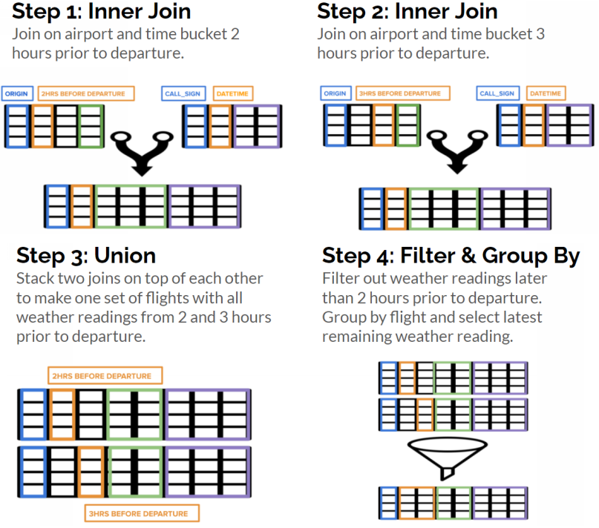
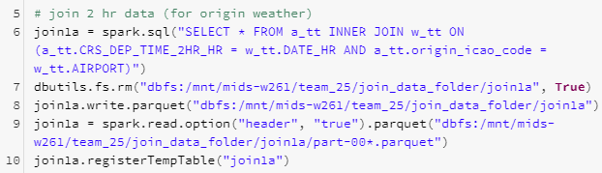
Data Processing: Data Join
Flights & Weather Data Join
Flights airport code (IATA <-> ICAO)
Flights datetime transformation
Flights timezone adjustment
Join on data 2-hours prior
Notes:
John
We took a 4 step approach to joining our airline and weather data. To prepare, we substituted IATA codes with ICAO codes to ensure all airports mapped to weather stations and then converted all dates into a UTC datetime metric.
We did inner joins on both 2 and 3 hour prior weather readings and unioned those tables, resulting in all recent weather readings. We then filtered to just get the most recent weather reading prior to prediction time.

Slide 11
Feature Engineering: Selection and Transformation
Variable Type
Categorical
One Hot Encoded for Regression
Numerical
Normalized for Regression
Month Day of week Carrier Origin airport Origin state Destination airport Destination state Departure time (4 hr bins) First departure (Yes/No binary) | Elapsed Time Distance
Wind speed (Beaufort scale bins) Ceiling height (Limited/Unlimited binary) Visibility distance (+/- 10 miles binary) Visibility variability | Latitude Longitude Elevation Temperature Dew point Sea level pressure
Airlines
Data
Source
Weather*
*All weather variables included for both origin and destination weather stations 2 hours prior to departure
Altered from original numerical format to bins
Notes:
JACLYN
We landed on 31 features from our raw data set - all of which are available at prediction time and are widely collected.
Highlighted in green are the variables with abnormal distributions that we binned

Slide 12


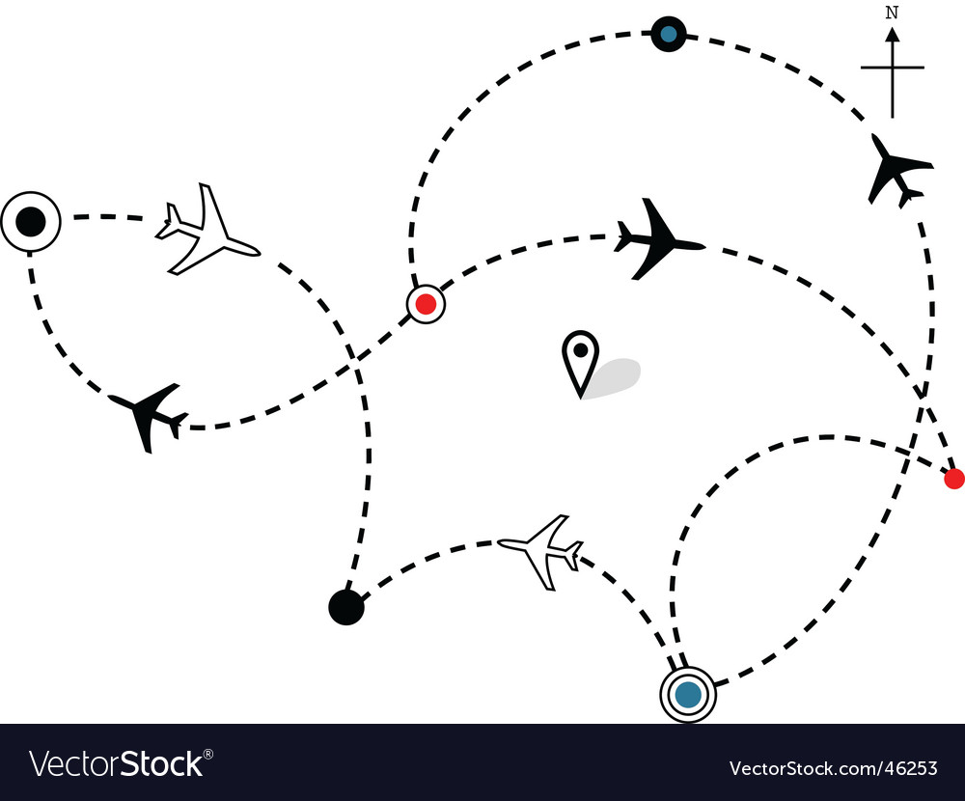
Feature Engineering: Creation
Delay Propagation (Tail # Previous Delay)
Derived from: flight delay data available 2 hours prior to flight departure.
Values: 0 (no prev. delay), 1 (prev. delay)
Missing: Default value of no previous delay
Derived from: CRS flight schedule*
Values: numeric, # of flights
Missing: *assumption: schedule is provided and determined at least a full day in advance.
Flight Schedule
(# of flights per day)
Derived from: Directed flight path graph weighted by number of flights along the path.
Values: rank between 0 and 1
Missing: imputed with 1/(# of airports in training data)
Airport Importance
(PageRank)
Notes:
JACLYN
We then created 3 custom features that given the common reasons for delays we thought would be helpful in prediction.
Delay propagation uses the tail # to track if the planned aircraft for our flight was recently delayed in the same day.
Our flight schedule tracks the total volume of flights in a day, we are assuming that the full schedule will be available at least one day in advance and able to be fed into our pipeline.
Origin airport PageRank was created to capture the flow across the airport network and highlight important airports with heavy incoming traffic.

Slide 13
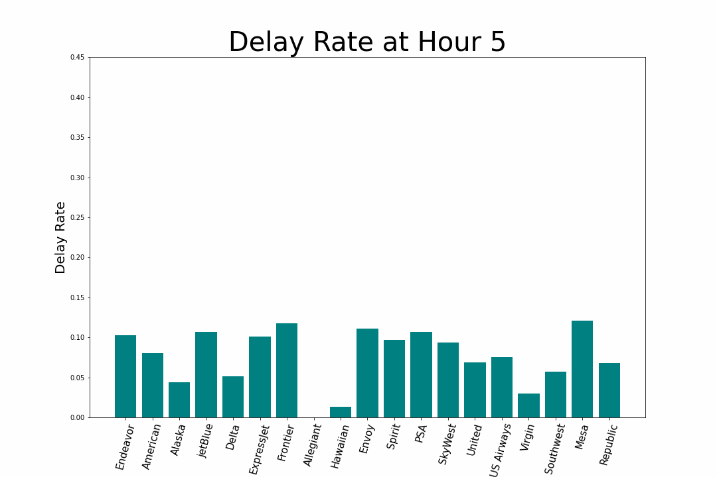
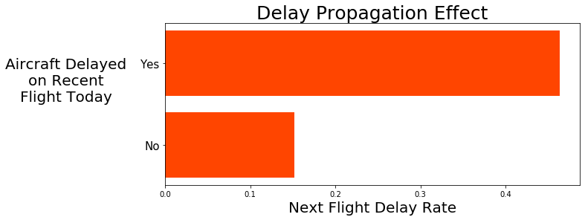
Feature Engineering: Delay Propagation
Delay rate increases throughout the day across all airlines
Major cause of delay is late aircrafts
Features to include:
Time of day
Binary first flight of day
Aircraft’s last flight delay status
Notes:
JACLYN
After discovering that a main cause of delays are late aircrafts, we dug further into time of day and noticed that across nearly all airlines, delay rate increases throughout the day. So we included time of day, a binary indicator of whether the flight was the first of the day and then our own measure of delay propagation. We can see here that flights with aircrafts who were previously delayed have a significantly higher chance of being delayed.

Slide 14
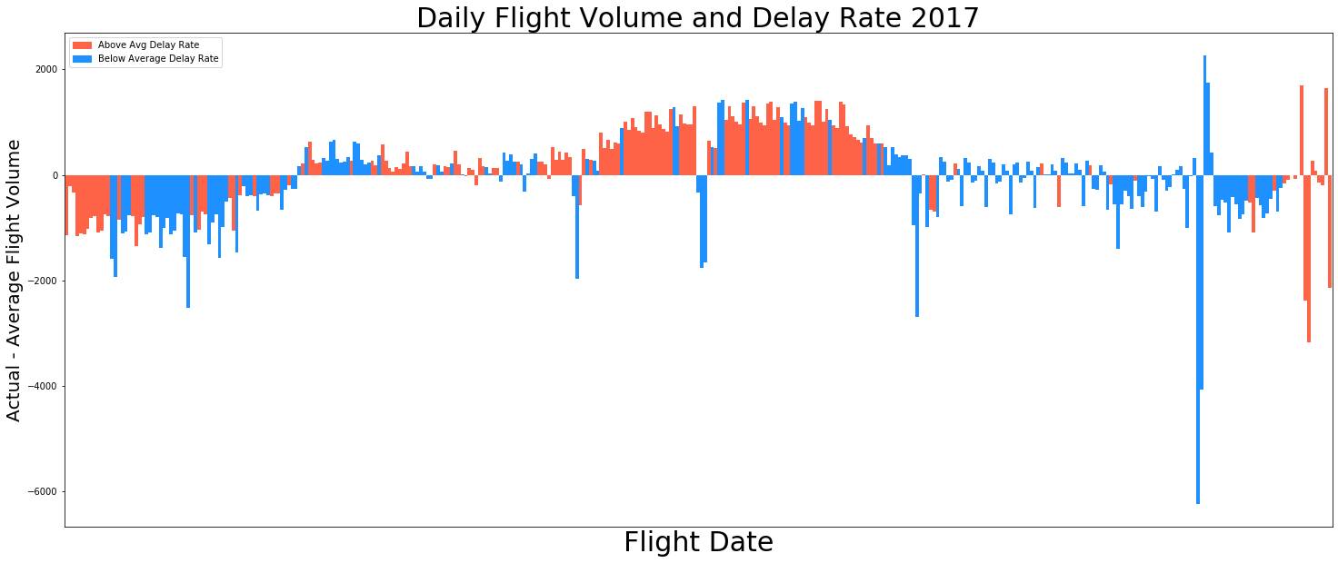
Feature Engineering: Flight Schedule
Summer
Winter
Holidays
Notes:
JACLYN
In addition, flight volume fluctuates seasonally. This graphic highlights the differences between actual and average flights per day in 2017. Schedules are light in the winter, heavy in the summer and have clear peaks and valleys during and around holidays. Higher delay rates (red) seem to be more in line with flight volume than inclement weather, with a large stretch of high delay rates happening in the summer. We built a flights per day variable to account for this and then moved onto modeling.

Slide 15




Algorithm Exploration: Baseline
Logistic Regression
F1-Score: 0.372
Decision Tree
F1-Score: 0.374
Random Forest
F1-Score: 0.402
Gradient Boosted Tree
F1-Score: 0.413
Notes:
ALYSSA
We created all of our baseline models on the 3 month dataset consisting of flights from Atlanta and Chicago O’Hare. For each of the baseline models we used all of the original features in the dataset.
In our EDA, we noticed that there was not an equal distribution of flights with a delay compared to flights without a delay, so we used class weighting to take care of this issue in all of these models.
We started with a logistic regression model, then moved onto a decision tree and only saw a slight improvement in F1 score.
We next tried a random forest model and saw a larger F1 score improvement. Then to further build on this we created a gradient boosted tree model.
Since our goal was to optimize F1 score and the gradient boosted tree model had the best F1 score, we proceeded with this model and then worked to improve it.

Slide 16
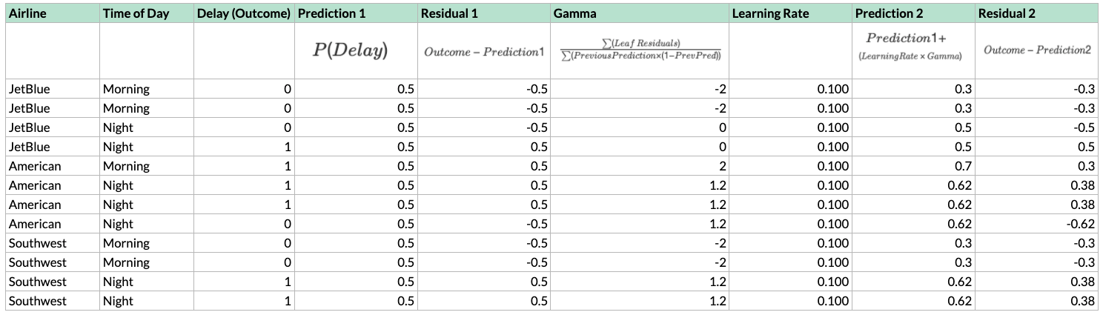
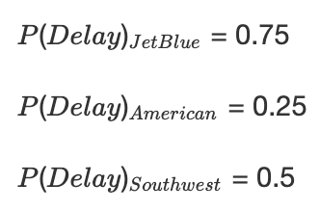
Algorithm Implementation: Toy Example
Split 1
Split 2
American Southwest JetBlue
Notes:
JACLYN
1 (dataset) So I’m going to walk through the math behind gradient boosted trees. Here’s a mini dataset with two features to predict flight delays.
2 (highlight airline variable - show Breiman’s) Our airline variable has 3 classes. Instead of one hot encoding airline like we did for regression, Spark works more efficiently by calculating the delay rate for each airline and ordering them to reduce the potential split points. This is called Breiman’s method.
3 (table up through residual with prediction and residuals highlighted) Now, to set up for our gradient boosted tree, we first find the total delay rate, 0.5, and a residual for each observation. This is what we would guess with no feature knowledge. This will be important in a minute. Now we create our decision tree using Spark’s default impurity metric - the gini index.
https://blog.paperspace.com/gradient-boosting-for-classification/

Slide 17
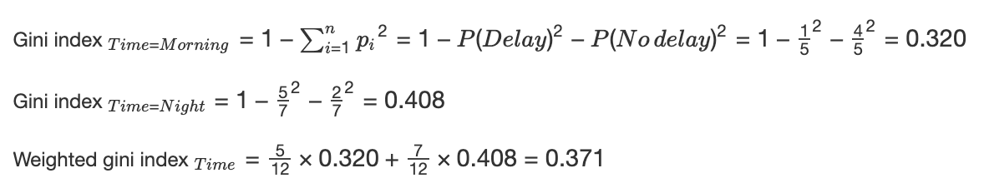
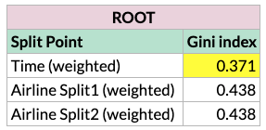
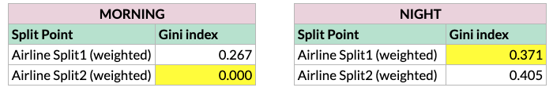
Algorithm Implementation: Toy Example
Notes:
JACLYN
4 (gini formula) We are looking for a split that makes our leaves as pure as possible, avoid leaves with an even mixture of delays and on time departures. Here is the formula and calculations for a single split point, resulting in a gini index of 0.371.
5 When we calculate the rest, we find Time is the most pure and use that for our initial split.
6Then repeat this method for layer 2 of the tree. And here’s what it looks like.
https://blog.paperspace.com/gradient-boosting-for-classification/

Slide 18
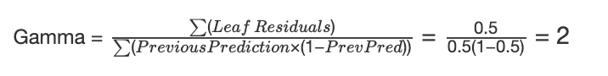
Algorithm Implementation: Toy Example
Time
Morning
Night
Airline
Airline
JetBlue, Southwest
American
JetBlue
Southwest, American
NO DELAY
DELAY
NO DELAY
DELAY
-0.5, -0.5, -0.5, -0.5
0.5
-0.5, 0.5
-0.5, 0.5, 0.5, 0.5, 0.5
-2 2 0 1.2
Notes:
JACLYN
7(tree) We could stop there and use this decision tree for prediction, but instead with a GBM we highlight the areas this tree didn’t predict well and improve there.
8 (residuals under tree) To do that, we place our residuals on their respective leaves and calculate a gamma value for each leaf. The gamma value has a longer derivation but ultimately stems from us minimizing the log loss function.
9 The formula and calculation for leaf 2’s gamma is here. Gamma’s sign and magnitude will indicate the direction and relative change from the last prediction that you are moving.
10 Here are all 4 gamma values.
https://blog.paperspace.com/gradient-boosting-for-classification/

Slide 19
Algorithm Implementation: Toy Example
Notes:
JACLYN
11 (full chart) Relative because we first multiply by a learning rate like we always do with gradient descent to ensure that we don’t overshoot the correct prediction.
12 We add that to our previous prediction of 0.5 and now we can see we’ve moved in the right direction. Delayed flights prediction increased, on time departures decreased. From there, we would run another tree using the residuals as the outcome variable and repeat.

Slide 20

Tuning
Individual Feature Inclusion:
PageRank
Delay propagation
Destination weather
Flight schedule
Hyperparameters:
Maximum depth
Maximum iterations
Minimum instances per node
Other:
One hot encoding
Top 10 features from other models
Principal component analysis
Included in final model
Not included in final model
Notes:
ALYSSA
After running our initial baseline gradient boosted tree model we ran several additional models before arriving at a final solution.
This slide shows the various approaches we tried along with what we included in our final model.
For testing purposes we continued to work with a 3 month dataset, but switched to a dataset that included all airports as we needed this to test some of our engineered features.
When adding in the features we saw that delay propagation resulted in a significant F1 score improvement while flight schedule actually decreased our model’s performance, so we therefore chose to exclude it.
We tried reducing the number of features in our model to reduce the computational complexity and found that PCA was the best solution for this.
After this testing and tuning, we arrived at our final gradient boosted tree model.

Slide 21
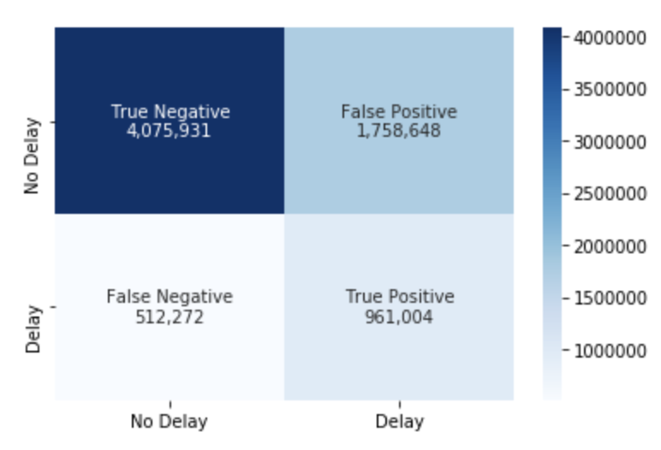
Final Algorithm
Gradient Boosted Tree
PCA with 10 components
Maximum depth = 6
Maximum iterations = 20
Minimum instances per node = 1
Results
F1 Score: 0.458
Recall: 0.652
Precision: 0.353
Accuracy: 0.689
AUC: 0.743
Notes:
We verified our model by making predictions on the training data. We saw a 0.05 difference in accuracy between predictions on validation data as compared to training data. Since this is not a drastic difference, we can tell that our model is not significantly underfitting or overfitting.
This confusion matrix displays the results of our final model. We see that of the flights that were actually delayed we are now predicting 65% of these correctly. This is a 20% improvement from our initial baseline model. We also see that we have optimized F1 score while also minimizing false negatives. Our F1 score of 0.458, is a 0.05 improvement from our initial gradient boosted tree model.
Using our model, airlines could predict 2 hours prior to a flight's departure if a flight will be delayed by 15 or more minutes or cancelled with about 70% accuracy. Although this is not the most accurate model, we have minimized false negatives and using our model, airlines and passengers can have confidence that they would have time to prepare for a delay in order to hopefully reduce the high cost of delayed flights.

Slide 22
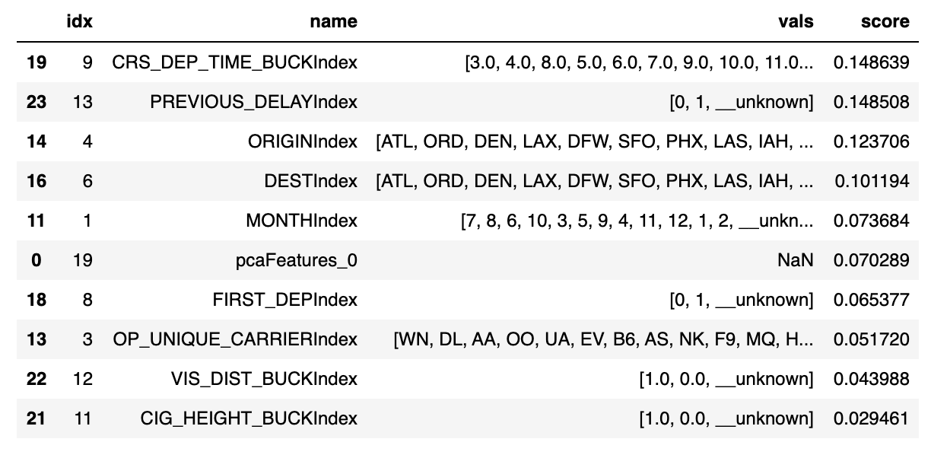
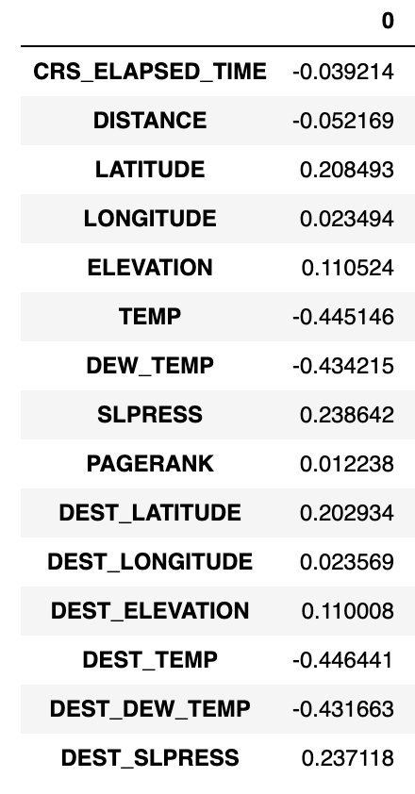
Feature Importance
Top 10 Important Features
pcaFeatures_0
Notes:
We analyzed our model to see what features were most important in predicting delays.
We see that the most important feature is the departure time and the second most important feature is the feature we created indicating if the previous flight was delayed.
We also see that the 6th most important feature is one of the features created through PCA, `pcaFeatures_0`. In the "PCA Feature Importance" table on the right, we see that both the origin and destination temperature and dew temperature were most important in creating this feature. This makes sense that PCA helped to account for multicollinearity among these 4 features.

Slide 23

Conclusion
Performance and scalability
Gradient boosted trees can’t fully be parallelized
Future work
Additional engineered features
Hyperparameter tuning
Split data at very beginning of pipeline
Notes:
Since gradient boosted trees are sequential in nature and train one tree at a time, they cannot be fully parallelized. However, due to reducing the number of features in our model by using PCA, we were able to train our model in a relatively short amount of time.
Additionally if we had only used a random forest model, we may have needed a larger tree depth, which may have increased computational complexity.
There are several ways in which our model could still be improved upon.
Potentially more features could be engineered and added to the model, such as a more specific flight schedule.
Additionally, more tuning could be done to adjust hyperparameters.
Overall, our entire end to end pipeline of our model could be improved by splitting the data into train, test, and validation at the very beginning of the process, but this would result in the joining of the airlines and weather data being more computationally intensive.
Including a more robust weather forecasting method could also help to improve the usability of this model, as well as improving the model to predict more in advance of a flight’s departure.
While we made great improvements from our initial baseline model, our model does not beat the state of the art. It would need some of the future work we described to further improve.
Thank you. Any questions?

Slide 24
Bibliography
Lukacs, Michael. “Cost of Delay Estimates.” FAA, 2019, www.faa.gov/data_research/aviation_data_statistics/media/cost_delay_estimates.pdf.
“OST_R: BTS: Transtats.” BTS, 2020, www.transtats.bts.gov/DatabaseInfo.asp?DB_ID=120.
“Land-Based Datasets and Products.” National Climatic Data Center, 2020, www.ncdc.noaa.gov/data-access/land-based-station-data/land-based-datasets.
Belcastro, Loris, et al. Using Scalable Data Mining for Predicting Flight Delays. Dec. 2014.
Chakrabarty, Navoneel. A Data Mining Approach to Flight Arrival Delay Prediction for American Airlines.

